Slide 1

Thank you to the OCA Sponsors

Slide 2

OCA Days Online 2020
How to run your own runbot
October 16, 2020

Slide 3
Odoo runbot : session targets
Learn how to install a runbot instance
  Odoo setup, postgresql, nginx, docker, github
Understand the concepts used by runbot
Configure your projects to be able to test them with runbot
We will be using the latest and greatest version of runbot and odoo 13.0
  Note: this is not the current setup of OCA Runbot
    But I'm thinking hard about how we can migrate :-)
Prerequisites:
  linux system administration (nginx, docker, postgresql)
  Odoo administration

Slide 4
Credits
Many thanks to the Odoo developers who made runbot
Special mention to Olivier Dony, whose help when I started working on the OCA Runbot was priceless
Speaking of the OCA Runbot, thanks to Moises Lopez who wrote travis2docker which is a key component of the current OCA runbot stack

Slide 5
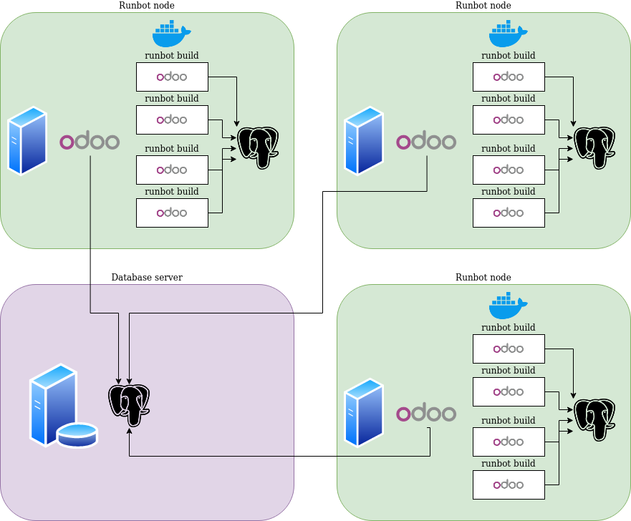
Architectural overview

Slide 6
System requirements
On each runbot node you plan to run you will need
  A DNS entry
  Some disk space, to store the docker data and the databases
  Lots of RAM (each runbot build will consume >800MB)
  Some CPU power (to run tests, or to allow the runbot runs to be useable)
  A good internet connection
But for testing a simple server is enough
  The demo server I'm using has 2 ARM cores@1.7GHz and 4GB of RAM

Slide 7
DNS setup
For convenience I recommend giving a A and AAAA record for each node as runbotN.yourdomain.org.
Then add a CNAME for one of the node that will be used as the public web frontend
And add wildcard CNAME records for each node
runbot1 10800 IN A 136.243.8.166
runbot 300 IN CNAME runbot1
*.runbot 300 IN CNAME runbot1
*.runbot1 10800 IN CNAME runbot1
runbot2 10800 IN A 144.76.217.244
*.runbot2 10800 IN CNAME runbot2
runbot3 1800 IN A 46.4.84.118
*.runbot3 1800 IN CNAME runbot3

Slide 8
Sysadmin preparation
On each runbot node you plan to run you will need
  Git
  PostgreSQL
  Nginx
  Python3 (we will be using virtualenv to manage dependencies)
  Docker
Docker has special instructions, see https://docs.docker.com/engine/install/
The others should be available in your Linux distribution

Slide 9
PostgreSQL: global database
One of the servers will be running a PostgreSQL instance which will host the runbot database. We will use runbotdb for the database name
It will be accessed by all the runbot nodes
  If the server running this instance is also a runbot node, I recommend using a different postgresql cluster which will not run on the default port 5432
You need to
  Create a database user odoo and give him a password
  Create the databases runbotdb and odoo with user odoo as the owner
  Edit postgresql.conf to listen on a public network interface, and allow ssl
  Edit pg_hba.conf to allow access to the databases odoo, postgres and runbotdb from other nodes for user odoo (don't forget to do this each time you add a node)

Slide 10
Global database setup
$ sudo su – postgres
$ pg_createcluster -p 5444 12 runbot
$ pg_cltcluster 12 runbot start
$ createuser -p 5444 odoo
$ createdb -p 5444 -O odoo odoo
$ createdb -p 5444 -O odoo runbotdb
# pg_hba.conf
hostssl odoo,postgres,runbotdb odoo 144.76.217.244/32 md5 # runbot2
hostssl odoo,postgres,runbotdb odoo 136.243.8.166/32 md5 # runbot1
hostssl odoo,postgres,runbotdb odoo 46.4.84.118/32 md5 # runbot3

Slide 11
PostgreSQL : node database server
On each runbot node you need to have a postgresql server running and listening on the default port (5432)
Create a user odoo with database creation privilege
If you plan to have a lot of builds on the nodes, you will probably need to tune a bit the cluster's parameters
  Increase max_connections
  Decrease work_mem (if needed)
  Disabling fsync speeds up the build (we don't care about data integrity here)
  Disable track_counts and autovacuum (we don't care about statistics for the query optimizer, the databases are small)

Slide 12
Node database setup
$ sudo su - postgres
$ createuser --createdb odoo
$ createdb -O odoo odoo
# postgresql.conf, end of file, this is postgresql 11
listen_addresses = 'localhost,runbot3'
ssl=true
max_connections = 2000
maintenance_work_mem = 1GB
shared_buffers = 512MB
work_mem = 4MB # decrease work_mem to be able to increase max_conn
wal_buffers = 8MB
max_wal_size = 256MB
checkpoint_completion_target = '0.9'
effective_cache_size = 2GB
fsync = off # no important data in the database
track_counts = off # shortlived db -> not needed
autovacuum = off # can't work without track_counts anyway

Slide 13
Docker setup
Most important thing: Docker will be use to run the runbot builds, not the odoo instances which manage the builds
On each node, make sure the odoo user is able to use docker
$ sudo adduser odoo docker

Slide 14
Nginx setup
Runbot manages its own nginx configuration
  Reverse proxy listening on port 8080
  Based on server name, will redirect on for the main node instance (expected to listen on 8069) or on a build
Needs an undocumented configuration parameter in Odoo to work properly (more on this later)
You will need to install a second layer of reverse proxy to listen on port 80, and handle SSL certificates
  But you cannot change the qweb template to generate an nginx config listening on this privileged port, as the odoo system user will be running nginx

Slide 15
Global nginx setup 1/3
Example configuration (in /etc/nginx/sites-available/default)
server {
listen 80 default_server;
listen [::]:80 default_server;
root /var/www/html;
index index.html index.htm index.nginx-debian.html;
server_name runbotng.odoo-community.net;
location / {
proxy_pass http://runbotng.odoo-community.net:8080;
proxy_read_timeout 30s;
proxy_connect_timeout 5s;
proxy_redirect http://runbotng.odoo-community.org:8080/ http://runbotng.odoo-community.net/;
add_header X-Static no;
proxy_intercept_errors on;
}
location /longpolling/poll { return 404;}
location /longpolling/im/poll { return 404;}
location /robots.txt { return 200 "User-agent: *\nDisallow; /";}
}

Slide 16
Global nginx setup 2/3
Example configuration, c'ued (in /etc/nginx/sites-available/default)
server {
listen 80;
listen [::]:80;
server_name ~.*\.runbotng1\.odoo\-community\.net$;
location / { proxy_pass http://$host:8080; }
}

Slide 17
Global nginx setup 3/3
DNS configuration (in /etc/nginx/nginx.conf)
http {
# skipping what I kept
Resolver 62.210.16.6 62.210.16.7; # use the IP addresses of
# the DNS server of your
# hosting service
}

Slide 18
Odoo setup (finally)
Follow the instructions in the README.md of the runbot repository :-)
  github.com/odoo/runbot/blob/13.0/README.md
  It's mostly accurate (PR in progress to improve it), and contains valuable advice → read it!
  Create a virtualenv for python3
  Clone odoo/odoo (branch 13.0) and odoo/runbot (branch 13.0)
You may want to use github.com/gurneyalex/runbotsetup as a helper (still very rough, PRs welcome, tested on debian buster)
  The helper includes some settings that are recommended in the runbot repository README

Slide 19
Runbot node odoo installation
~$ git clone --recurse-submodules --shallow-submodules --jobs 2 \ https://github.com/gurneyalex/runbotsetup mr_runbot
~$ cd mr_runbot
~/mr_runbot$ ./install-deps.sh # install build dependencies
~/mr_runbot$ DBHOST=db.mydomain.org DBPORT=5444 DBPASSWD=xxxxx ./install.sh
~/mr_runbot$ vim runbot.conf # change admin password, tune log levels…
~/mr_runbot$ source venv/bin/activate
(venv) ~/mr_runbot$ ./run.sh
The runbot will put lots of data in the static directory of the runbot module
~/mr_runbot/src/runbot/runbot/static$ ls *
build:
00001-13-0 00002-master 00003-13-0 00004-13-0 00005-13-0 00006-13-0 00007-13-0 00008-13-0
docker:
docker_build.txt Dockerfile
nginx:
access.log error.log nginx.conf nginx.pid
repo:
Odoo test_runbot
sources:
Odoo test_runbot

Slide 20
Runbot setup
Don't forget to change the admin password on 1st connection, this is a public server!
The runbot addons changes stuff in the way Odoo works, especially regarding crons
  Changing some parameters in the global settings can require a restart to be taken into account (or a looooong wait)
Add an ir.config.parameter with name runbot.runbot_nginx and value 1
  This changes the way some of the fields are computed
  Not strictly required to test runbot on your workstation, but since we did all the nginx configuration, let's go the full way!

Slide 21
Runbot settings
When you go to the runbot app you land on a settings page
You need to enable
  Discover new commits
  Schedule builds
Set the domain
You can tune the number of workers and concurrent running instances, and various time limits

Slide 22
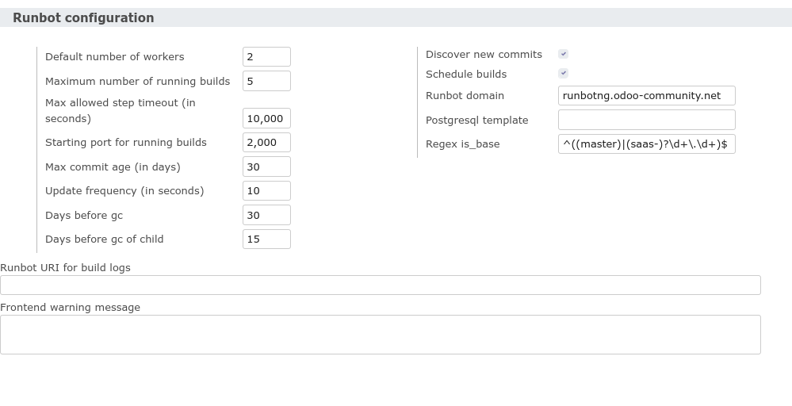
Runbot settings

Slide 23
Runbot hosts
When a new node is added, it automatically configures a new host record, with the name set to the fqdn of the node
Make sure Only accept assigned builds is unchecked
  By default, builds are not assigned to a host. Changing this requires tweaking the steps.

Slide 24
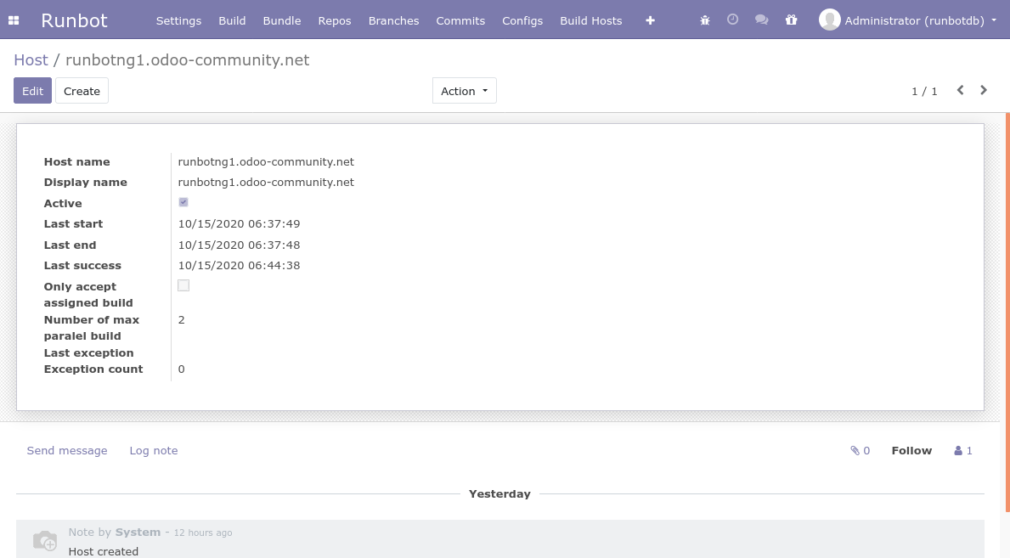
Runbot hosts

Slide 25
Runbot concepts: project
A project is a global configuration for the runbot, grouping repositories, triggers, bundles and builds
On the landing page of the runbot, you will get one page per project
In normal setups, you should be able to work with a single project
  But for more complex cases, it is possible to allow only members of some res.groups to see a project → this can be used to allow different customers to access only their own projects

Slide 26
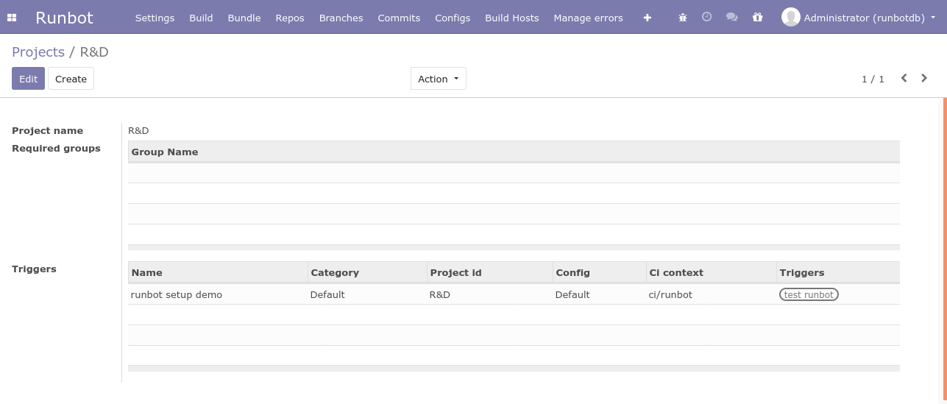
Runbot concepts: project

Slide 27
Runbot concepts: repository
Repository : this is a github repository for a project
  Don't use spaces in the name, or your builds will fail. Slashes are supported.
  If the repository has a server files field, then it is considered as an Odoo repository. Otherwise it is an addon repository
  Addons path: lists the path where the addons are. Leave empty for a pure addon repository where the addons are in the root
  Manifest file: use __manifest__.py for recent odoo versions. Used to find addons directories
  Identity file: the name of a file containing an ssh public key to be used to access remotes through git+ssh. The file must be in $HOME/.ssh/, the key must not have a passphrase

Slide 28
Runbot concepts: repository
Other fields
  Forbidden regex: a regular expression which is used to filter out branches. Branches matching the expression won't create bundles, and the value of Forbidden branch message is used in the status of the branch.
  Modules to install: list of modules to install, or not install (prefix with '-'), can use * as a wildcard.
  Tip: on the Odoo repository, use '-*,base' to speed up the testing of your own addons: that way, the 'all' step will only install the dependencies of the addons in your repository
  Mode: choose how we connect with github to know about new commits:
    Poll uses periodic polling
    Hook uses a notification hook (more on this later)
    Disable relies on manual polling.

Slide 29
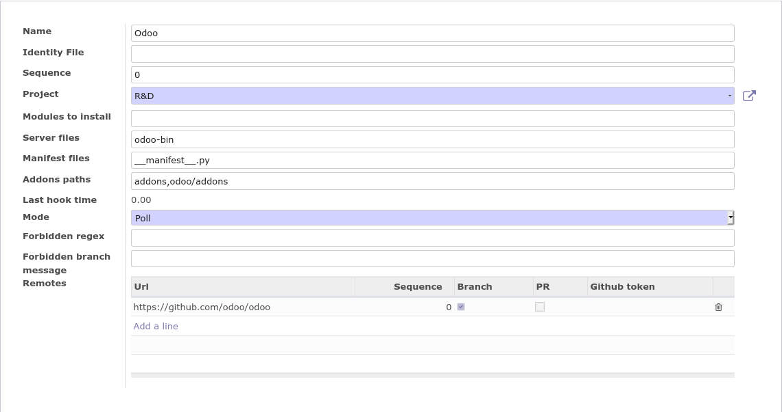
Runbot concepts: repository

Slide 30
Runbot concepts: remote
A repository can have different remotes. This can be used to track the main repository (e.g. an OCA project) and a fork in another organization
  A remote can be set to fetch branches and to fetch pull requests
  New branches or pull requests on the remote will trigger the creation of a bundle
Generally, you will add remotes from the repository form view
  Warning: there is a concept of a main remote on a repository, but the field is not displayed, and the logic in the code is fishy: the first added remote becomes the main remote, but deletion, order change is not properly managed.
  This main remote is used to manage the base branches → for now you must add the origin remote first.

Slide 31
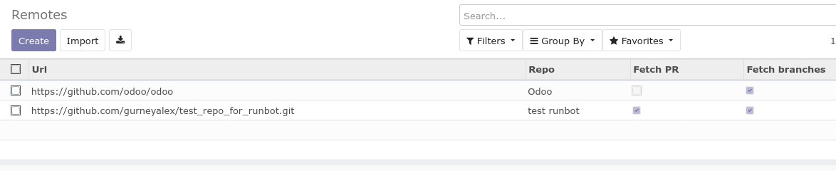
Runbot concepts: remote

Slide 32
Runbot concepts: trigger
A trigger links repositories together, and defines what the runbot is going to do when new commits are discovered on a remote of a repository
  The Triggers repositories are the repositories on which new commits will fire an action from runbot
  The repositories listed in Dependencies repositories are used to find the missing parts required to create a build
  Config is the build configuration which is going to be used
  Category sets the icon on the frontend
    I didn't figure out how it affects the period of the build. Maybe needs manual tweaking
  CI fields are for sending informations to github

Slide 33
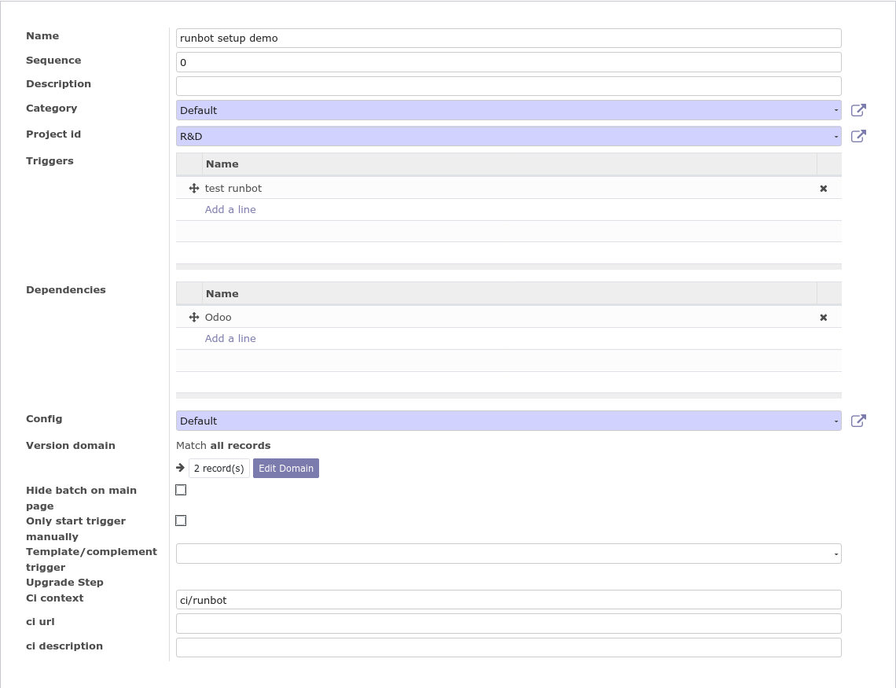
Runbot concepts: trigger

Slide 34
Runbot concepts: build config
A build config lists all the build steps that will be performed by a build
Each step can have different types (run tests, run odoo, trigger another build, test a version upgrade, restore a database...)
  Depending on the type, various options are provided
  We won't delve into configuring new build steps in this presentation, and we will stick to the pre configured steps
  There is a power type allowing to run Python code, which allows doing virtually anything → I will have to investigate this for the Odoo Community runbot :-)
The testing steps can list the modules to run tests on, and test tags to use

Slide 35
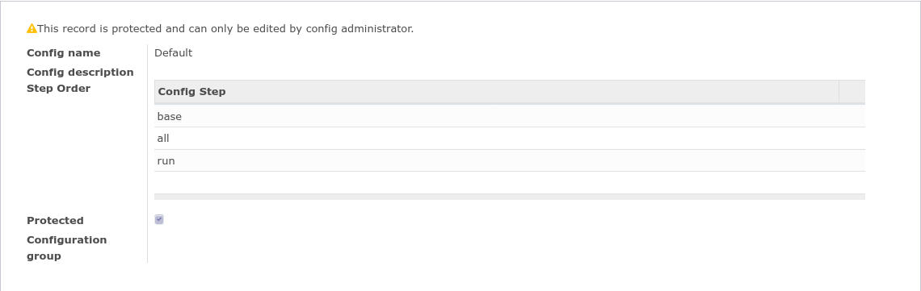
Runbot concepts: build config

Slide 36
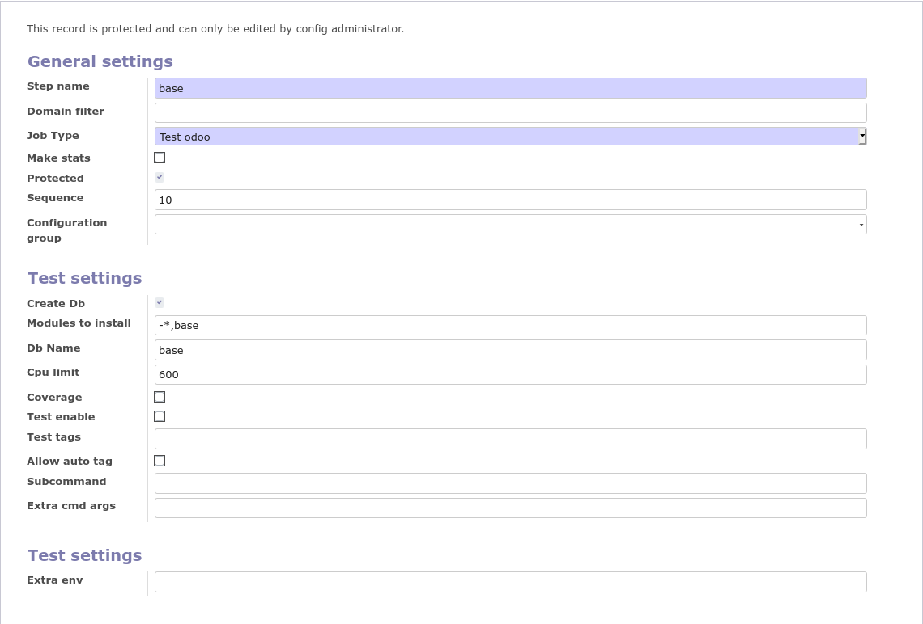
Runbot concepts: build config

Slide 37
Runbot concepts: bundle
A bundle groups branches that work together in a project
It contains all branches that share the same name in a given project
  You get special bundles for pull requests, which refer to a base bundle → the base bundle will be used to get the dependencies

Slide 38
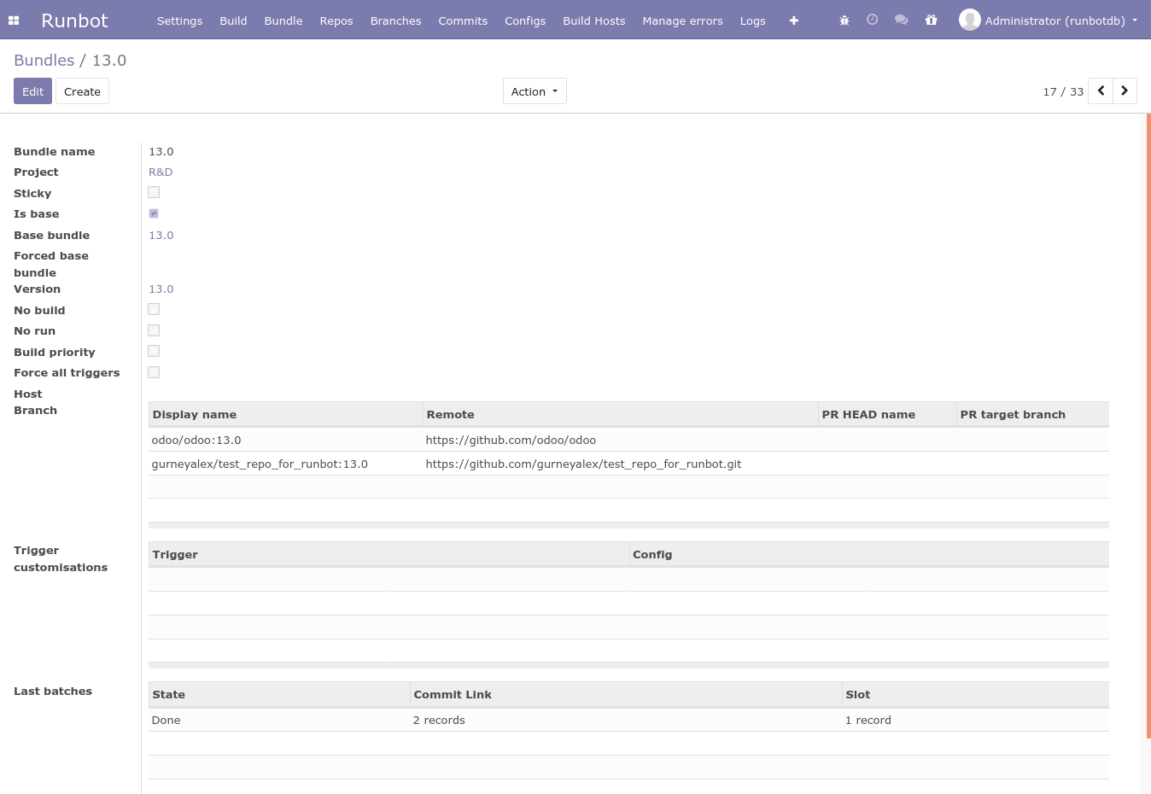
Bundle for a branch

Slide 39
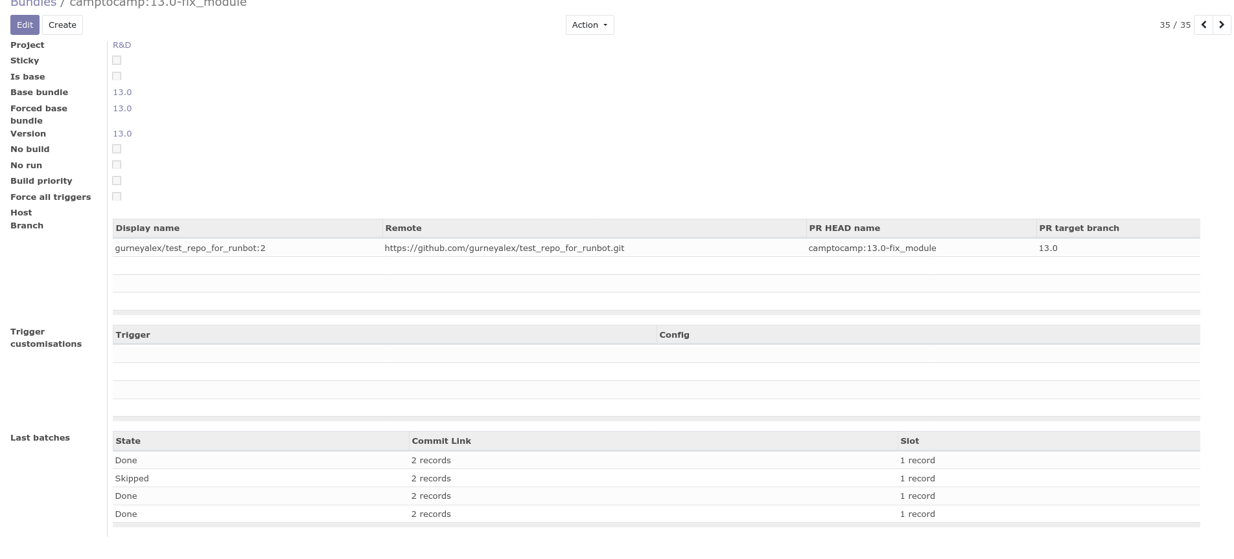
Bundle for a pull request

Slide 40
Runbot concepts: batch
A batch groups commits for a bundle
When a commit is pushed to a branch of a bundle, if a trigger exists for the repository, runbot will create a new batch
  New commits arriving with the next 60s will be added to the batch
  When no new commits have been found in the last minute, a build is created, which is linked to the batch

Slide 41
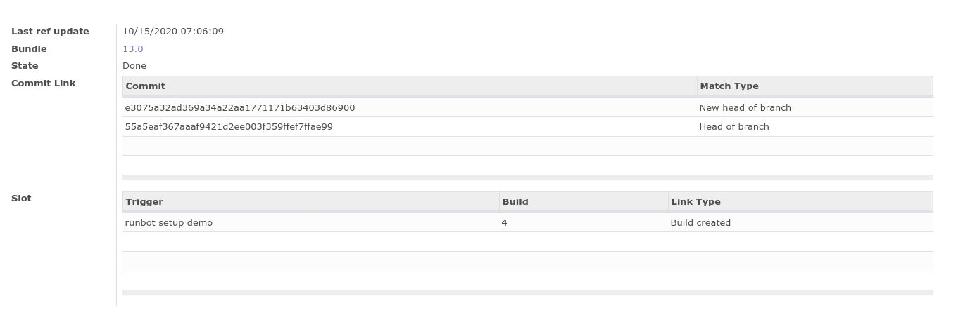
Runbot concepts: batch

Slide 42
Runbot concepts: build
Builds are what you are interested in: they apply a Build configuration to a Batch, and run the various steps listed in the configuration
The steps are run in docker containers
The front end is able to show all the information about the various results of the build steps, and as usual, if there's a “run” step, you will be able to log on the instance
  The logs are also available
  You can download a dump of the database + filestore from there too

Slide 43
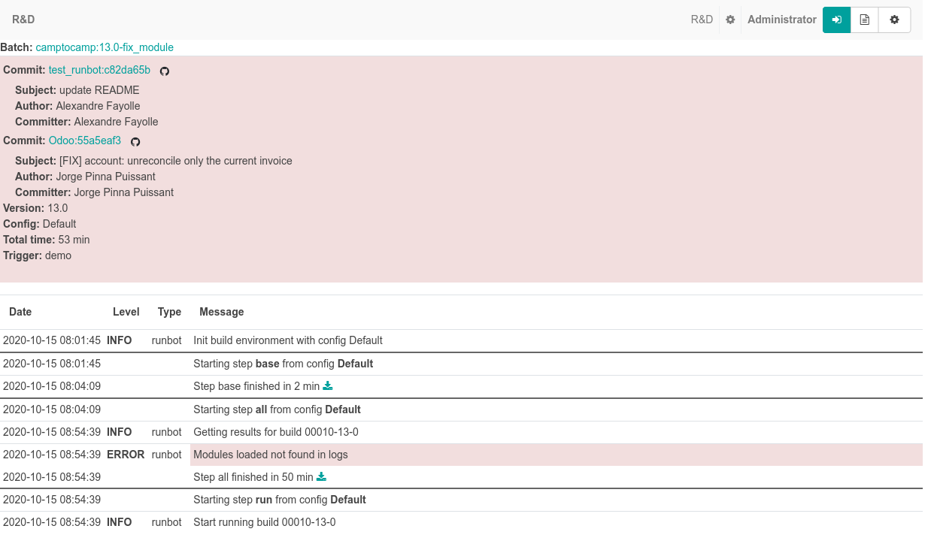
Runbot concepts: build

Slide 44
Github integration: Hook mode
In order to avoid polling repositories, configure the repositories you control in mode Hook, and setup a hook on the repository on github
  If you are working within a github organization, you can set up the hook globally for all repositories of the organization and saves a lot of time
To set a hook for a given remote
  Get the database ID of the remote
  Go to you github repository and navigate to Settings → Webhooks, and add a hook
  Payload URL is
  http://<runbotserver-url>/runbot/hook/<remote-ID>
  Select “send me everything”
For organization-wide hooks, the Payload URL is
http://<runbotserver-url>/runbot/hook/org

Slide 45
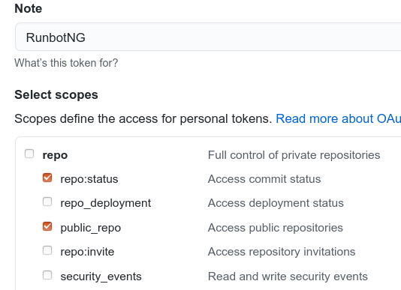
Github integration: CI notifications
If you want runbot to post the result of the build on pull request, you first need to generate a secret on your github repository
  Go to https://github.com/settings/tokens, create a new token
  Enable access to repo:status and repo:public_repo
  Not sure about private repositories
  → you'll have to test
  Copy the generated token to the Github token field of the branch
Bam, you're done (super fast)

Slide 46


Questions and Answers

Slide 47
Thank you to the OCA Sponsors

